Slide 1
AWS Fundamentals (v2.3)
Technical Team
Sep 2023

Slide 2
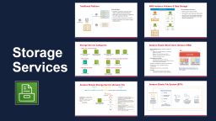
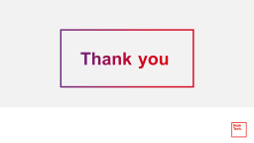
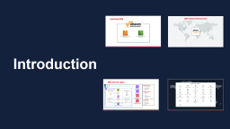
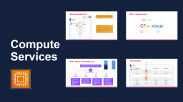
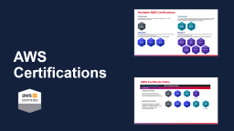

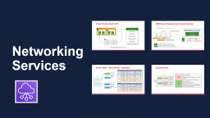
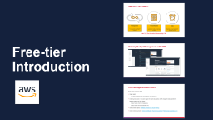

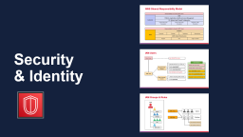
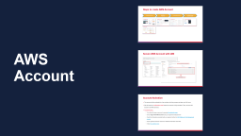
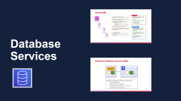
AWS Fundamentals - AGENDA
Main Goals
Understand AWS Core Concept
Has Awareness of AWS Global Infrastructure
Gain fundamental knowledge of AWS Networking
Understand basic Security in AWS

Slide 3
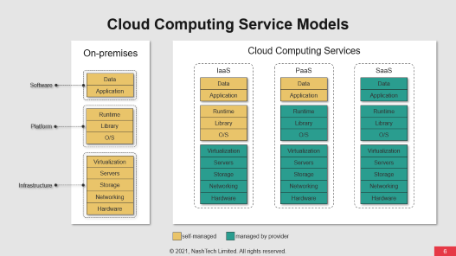
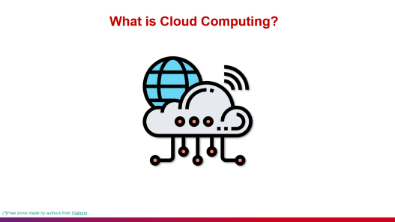
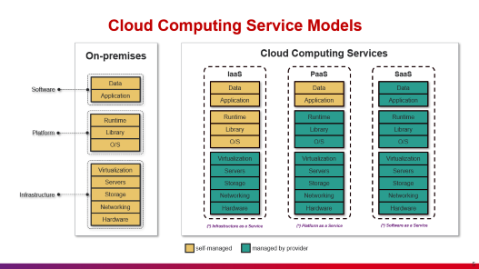
Quick Recap

Slide 4

What is Cloud Computing?
On-demand IT resources delivery
Accessible Online (Internet)
Pay-as-you-go Pricing
(*)Free Icons made by authors from Flaticon
Notes:
Cloud computing is the on-demand delivery of IT resources over the Internet with pay-as-you-go pricing.
The resources can servers, storage, databases, networking, software, analytics, intelligence, etc.
IT resources delivery
On-demand
Accessible online (Internet)
Pay-as-you-go pricing

Slide 5
Cloud Computing Service Models
On-premises
Cloud Computing Services
IaaS
PaaS
SaaS
Data
Data
Data
Data
Software
Application
Application
Application
Application
Runtime
Runtime
Runtime
Runtime
Platform
Library
Library
Library
Library
O/S
O/S
O/S
O/S
Virtualization
Virtualization
Virtualization
Virtualization
Servers
Servers
Servers
Servers
Storage
Storage
Storage
Infrastructure
Storage
Networking
Networking
Networking
Networking
Hardware
Hardware
Hardware
Hardware
(*) Infrastructure as a Service
(*) Platform as a Service
(*) Software as a Service
self-managed
managed by provider

Slide 6
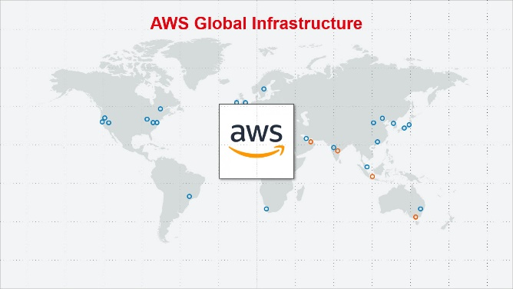
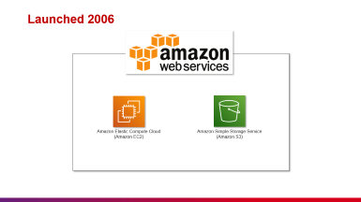
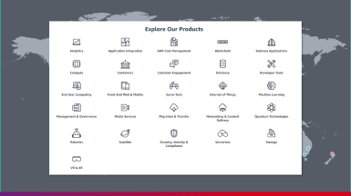
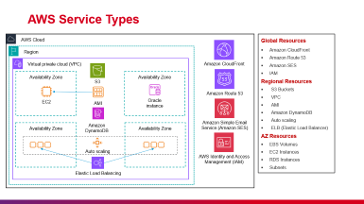
Introduction

Slide 7
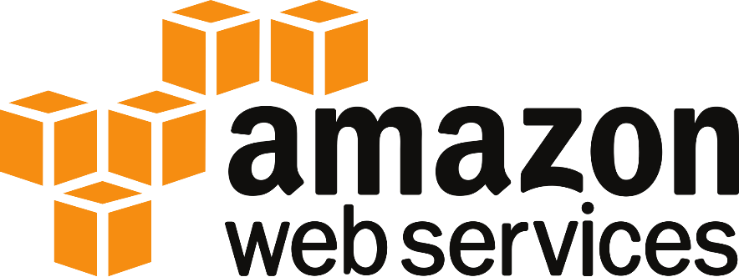


Launched 2006
Amazon Elastic Compute Cloud
(Amazon EC2)
Amazon Simple Storage Service (Amazon S3)

Slide 8
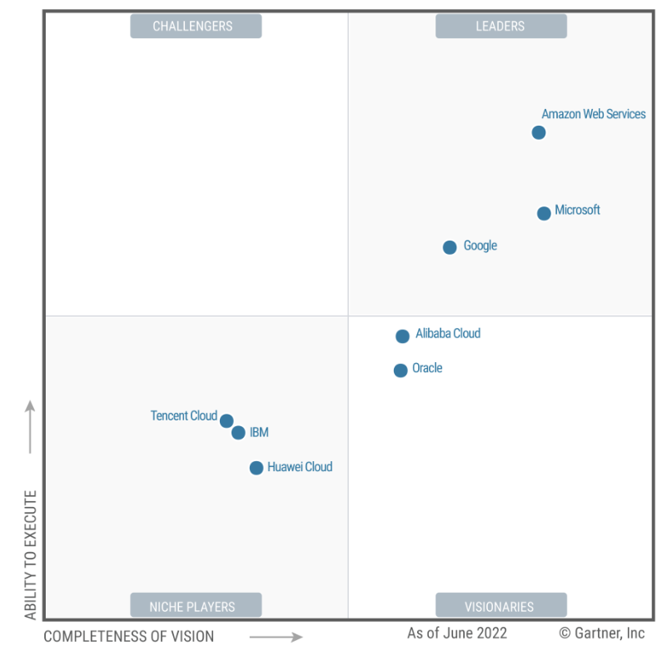
AWS Today
AWS Named as a Leader in the 2022 Gartner Cloud Infrastructure & Platform Services (CIPS) Magic Quadrant for the 12th Consecutive Year
(*) Source from Gartner reports on Dec 2022

Slide 9
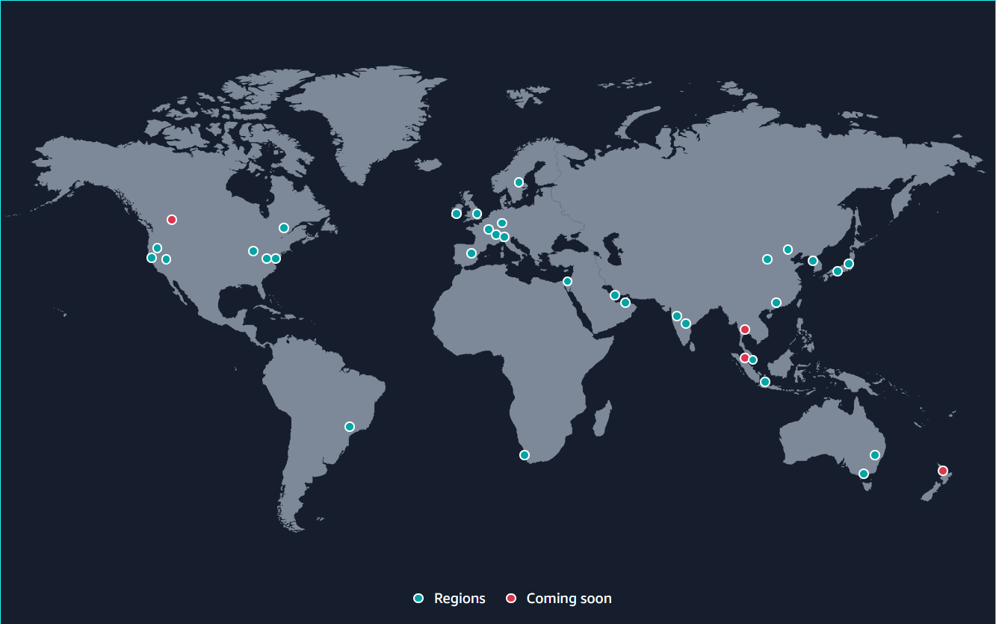

AWS Global Infrastructure
32 Launched Regions
with
102 Availability Zones
450+ Points of Presence
400+ Edge Locations 13 Regional Edge Caches
200+
Services
divided into
26
Categories
115 Direct Connect Locations

Slide 10
Regions & Zones
More information at Global Infrastructure (amazon.com)

Slide 11
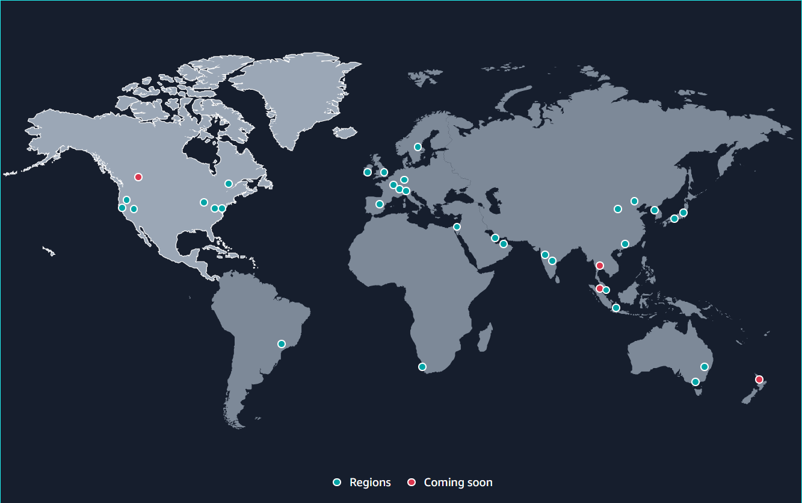
North America
Canada Central
AZs
3
Launched
2016
Canada West
Oregon
Ohio
AZs
4
AZs
3
Launched
2011
Launched
2016
North California
North Virginia
AZs
3
AZs
6
Launched
2009
LZs
12
WZs
8
Launched
2006
AWS GovCloud
US-West
US-East
AZs
3
AZs
3
Launched
2011
Launched
2018
AZs | Availability Zones
LZs | Local Zones
WZs | Wavelength Zones

Slide 12
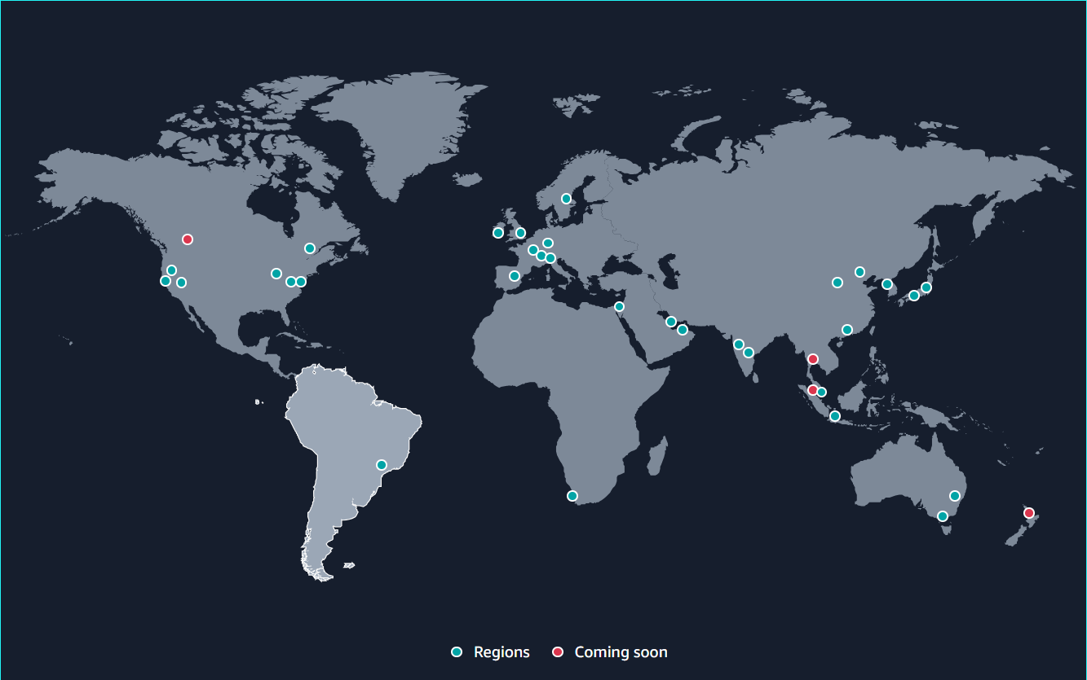
South America
São Paulo
AZs
3
Launched
2011
AZs | Availability Zones
LZs | Local Zones
WZs | Wavelength Zones

Slide 13
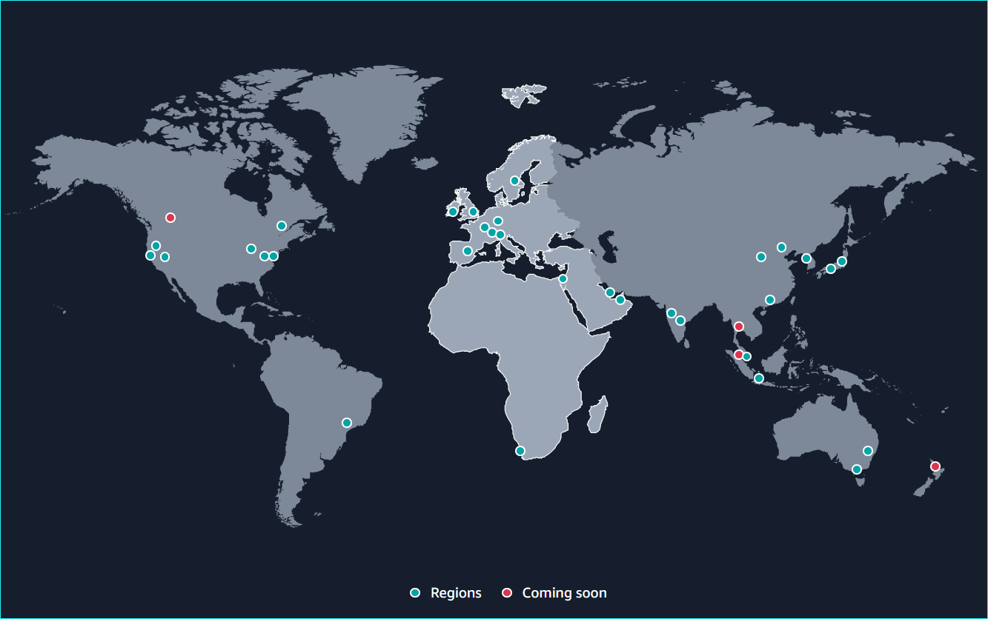
Europe – Middle East - Africa
London
Stockholm
AZs
3
AZs
3
WZs
2
LZs
2
Launched
2016
Launched
2018
Ireland
AZs
3
Frankfurt
Launched
2007
AZs
3
LZs
2
Paris
Launched
2014
AZs
3
Milan
Launched
2017
AZs
3
Spain
Launched
2020
AZs
3
Launched
2022
Bahrain
AZs
3
Zurich
LZs
1
AZs
3
Launched
2019
Launched
2022
UAE
AZs
3
Cape Town
Launched
2022
AZs
3
Tel Aviv
AZs | Availability Zones
LZs | Local Zones
WZs | Wavelength Zones
Launched
2020
AZs
3
Launched
2023

Slide 14
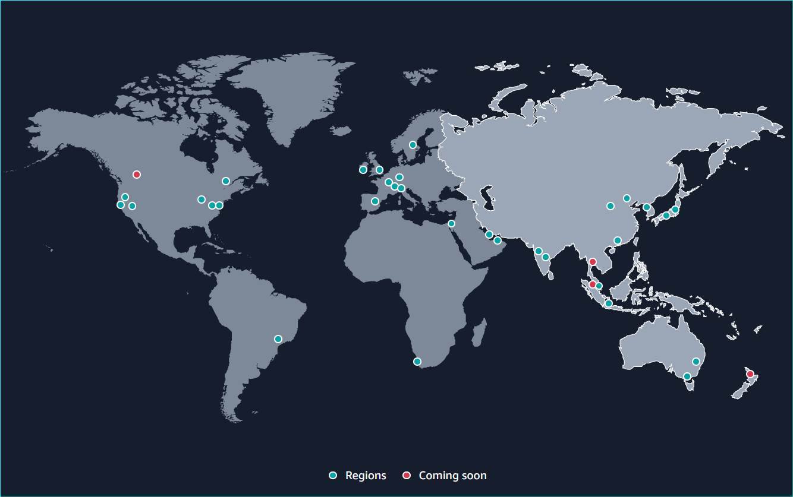
Asia Pacific – Australia and New Zealand
Seoul
AZs
4
Beijing
WZs
1
AZs
3
Launched
2016
Ningxia
AZs
3
Tokyo
AZs
4
Mumbai
LZs
1
AZs
3
WZs
2
LZs
2
Launched
2011
Launched
2016
Osaka
Hyderabad
AZs
3
AZs
3
Launched
2021
Launched
2022
Hong Kong SAR
Thailand
AZs
3
Launched
2019
Malaysia
Auckland
Singapore
AZs
3
Jakarta
LZs
1
AZs
3
Sydney
Launched
2010
Launched
2021
AZs
3
Melbourne
AZs | Availability Zones
LZs | Local Zones
WZs | Wavelength Zones
AZs
3
LZs
1
Launched
2023
Launched
2012

Slide 15


Region Structure
Region
Availability Zone
Availability Zone
Data center
Data center
Data center
Data center
Region | US West (Oregon)
Availability Zones (4) | us-west-2a
 | us-west-2b
 | us-west-2c
 | us-west-2d
Low latency resilient fiber connectivity
Availability Zone
Data center
Data center

Slide 16




Each Region is designed to be isolated from the other Regions.
This achieves the greatest possible fault tolerance and stability.
An extension of an AWS Region in geographic proximity to your users
Local Zones have their own connections to the internet and support AWS Direct Connect
Resources created in a Local Zone can serve local users with low-latency communications
Each Region has multiple, isolated locations known as Availability Zones.
Region (us-west-2)
Availability Zone
(us-west-2a)
Availability Zone
(us-west-2b)
Local Zone
(us-west-2-lax-1)
AWS Wavelength enables developers to build applications that deliver ultra-low latencies to mobile devices and end users.
Wavelength deploys standard AWS compute and storage services to the edge of telecommunication carriers' 5G networks.
Use AWS resources like Amazon EC2 instances to run applications that require ultra-low latency and a connection to AWS services in the Region.
A Wavelength Zone is an isolated zone where the Wavelength infrastructure is deployed in the carrier location.
Wavelength Zones are tied to a Region.
A Wavelength Zone is a logical extension of a Region and is managed by the control plane in the Region.
VPC
Local Zone
(us-west-2-lax-1)
Public subnet
Public subnet
Private subnet
VPC
Wavelength Zone
(us-west-2-wl1-den-wlz-1)
Public subnet
Public subnet
Private subnet

Slide 17











AWS Service Types
AWS Cloud
Global Resources
Amazon CloudFront
Amazon Route 53
Amazon SES
IAM
Regional Resources
S3 Buckets
VPC
AMI
Amazon DynamoDB
Auto scaling
ELB (Elastic Load Balancer)
AZ Resources
EBS Volumes
EC2 Instances
RDS Instances
Subnets
Region
Virtual private cloud (VPC)
Amazon CloudFront
Availability Zone
Availability Zone
S3
Amazon Route 53
EC2
AMI
Oracle
instance
Amazon DynamoDB
Amazon Simple Email Service (Amazon SES)
Availability Zone
Availability Zone
Auto scaling
AWS Identity and Access Management (IAM)
Elastic Load Balancing

Slide 18
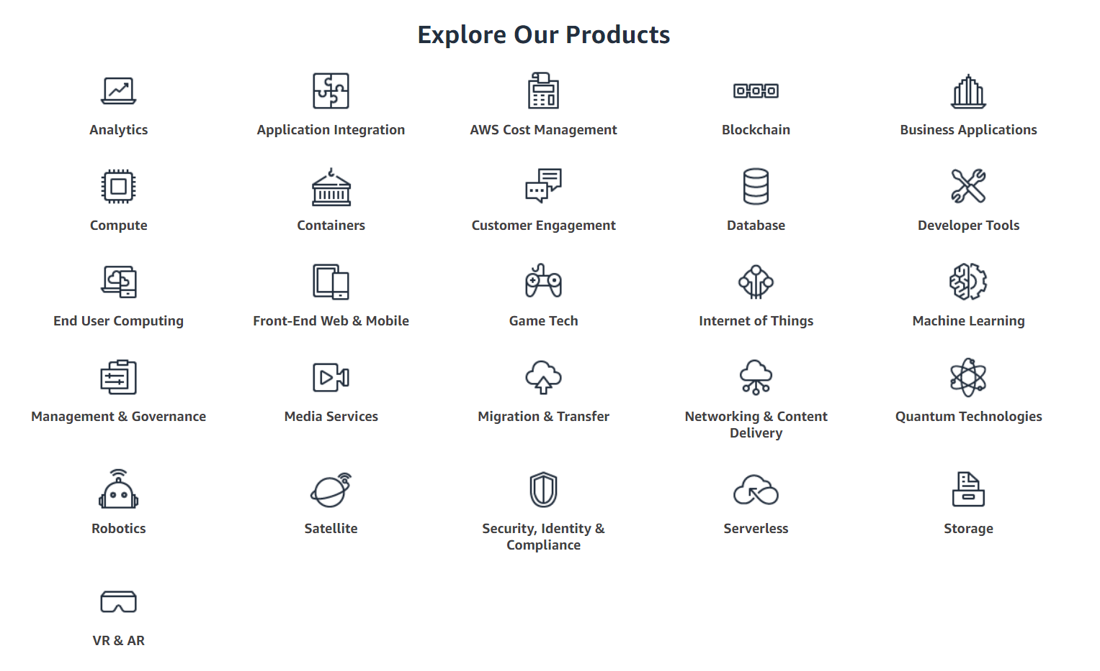

Slide 19
















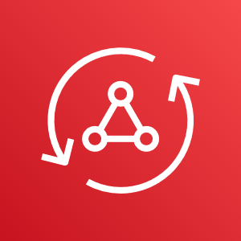

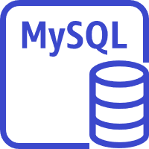
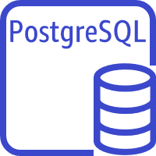
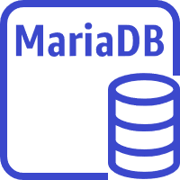

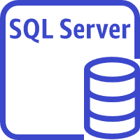


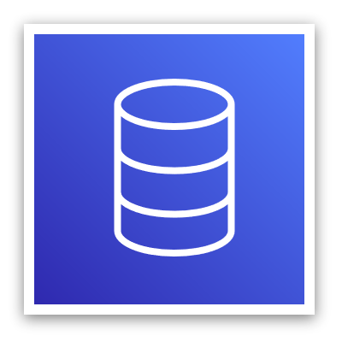












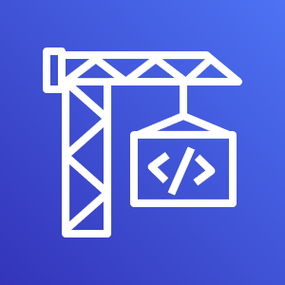

























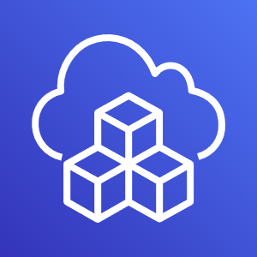







Identity & Access Management
Key Management Service
Shield
Amazon Cognito
CloudFormation
Amplify
Security, Identity & Compliance
Directory Service
Single Sign-On
Firewall Manager
CloudWatch
Device Farm
DynamoDB
Amazon Redshift
ElastiCache
Managed Cassandra Service
CloudTrail
AppSync
Amazon RDS
Amazon Aurora
OpsWork
Database
Mobile
Management
Elastic Block Storage
Simple Storage Service
S3 Glacier
Cloud9
Elastic File Storage
Storage Gateway
Backup
Athena
Storage
Kinesis
CodeBuild
Containerization
QuickSight
CodeCommit
EC2
Elastic Beanstalk
Elastic Container Registry
Elastic Kubernetes Service
Elasticsearch
CodeDeploy
Lambda
Lightsail
Elastic Container Service
Fargate
Compute
Analytics
CodePipeline
VPC
API Gateway
Direct Connect
Transit Gateway
AWS CLI
SNS
Route53
CloudFront
PrivateLink
Elastic Load Balancing
AWS CDK
Networking
SQS
AWS X-Ray
AWS Infrastructure
Step Function
Tools & SDKs
App Integration
Dev Tools

Slide 20
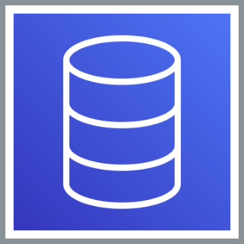




Our Focus
Database
Security
Compute
Storage
Networking

Slide 21
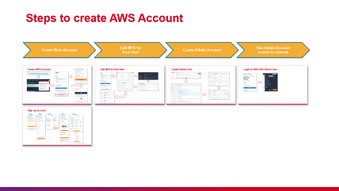
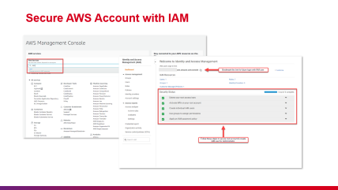
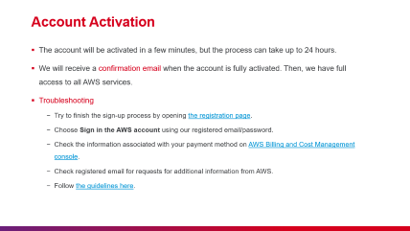
AWS Account

Slide 22
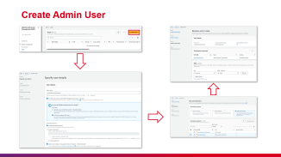
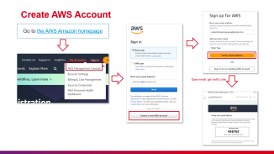
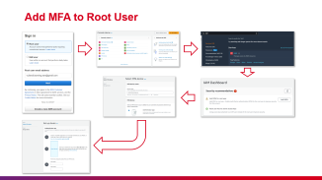
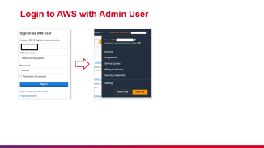
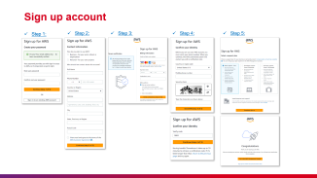
Steps to create AWS Account
Create Root Account
Add MFA for
Root User
Create Admin Account
Use Admin Account
access to console

Slide 23
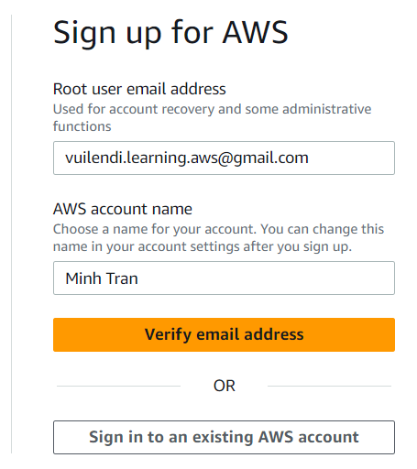
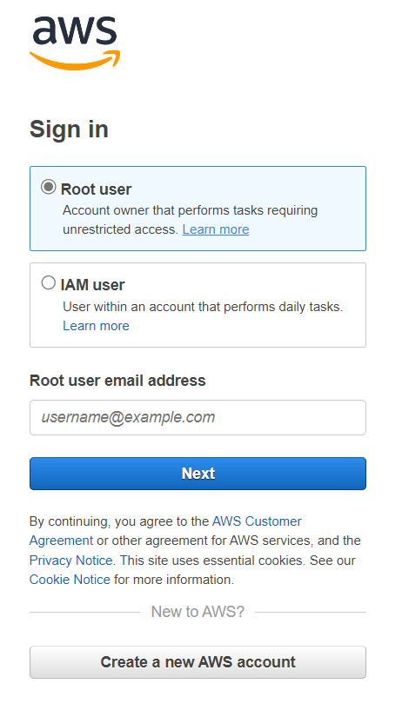
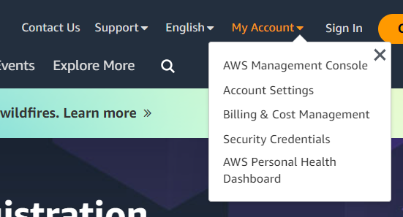
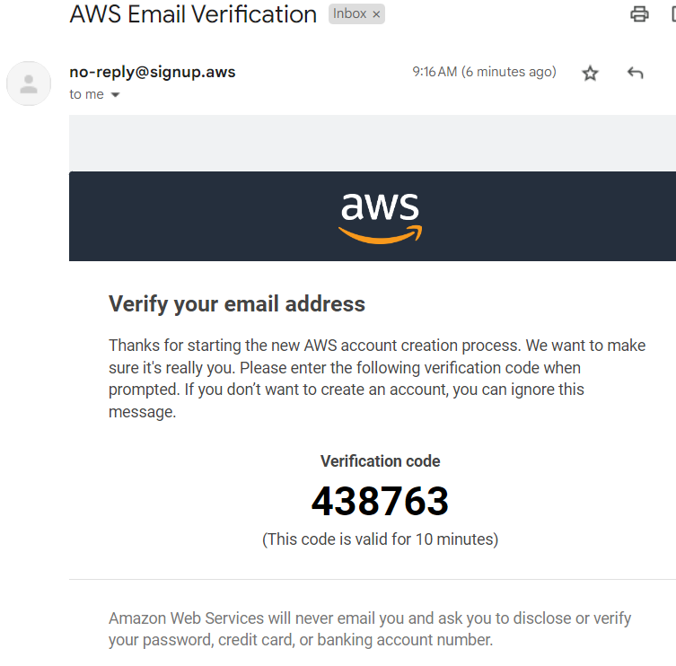
Create AWS Account
Go to the AWS Amazon homepage
Open email, get verify code

Slide 24
Account Creation
Important
After this step, we will receive a confirmation email. We can log in but not use any services until we finish the activation process.
If we have an AWS account email that closed before, it cannot be used to create a new one.

Slide 25
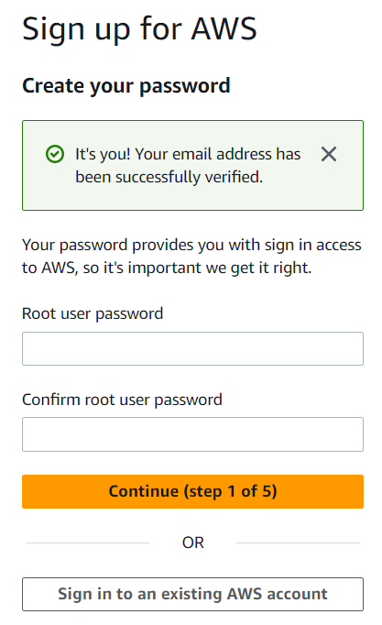
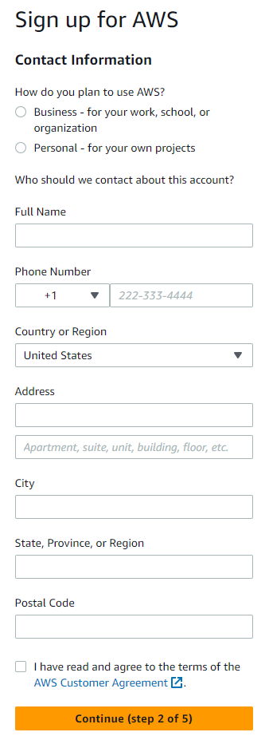
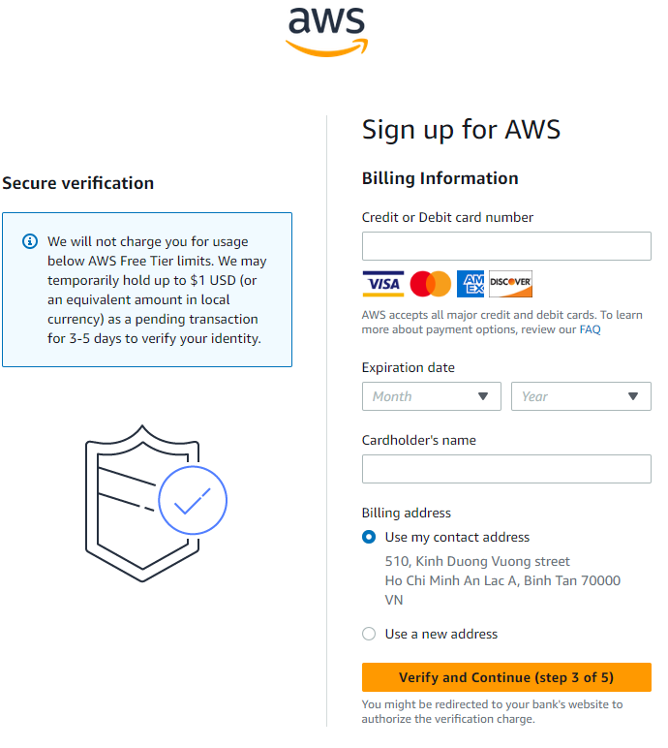
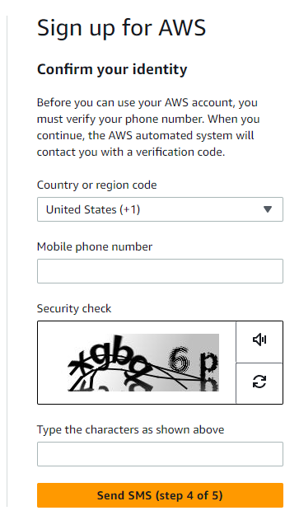



Sign up account
Step 1:
Step 2:
Step 3:
Step 4:
Step 5:

Slide 26
Payment Method
Important
We should use Mastercard/Visa debit/credit card, which supports international transactions.
AWS will charge 1 USD to verify the card, so make sure the card balance is not empty. The charge will be waived when the verification is completed.
We cannot proceed with the sign-up until we provide a valid payment method.

Slide 27






Add MFA to Root User

Slide 28




Create Admin User

Slide 29


Login to AWS with Admin User

Slide 30


Secure AWS Account with IAM

Slide 31
Account Activation
The account will be activated in a few minutes, but the process can take up to 24 hours.
We will receive a confirmation email when the account is fully activated. Then, we have full access to all AWS services.
Troubleshooting
Try to finish the sign-up process by opening the registration page.
Choose Sign in the AWS account using our registered email/password.
Check the information associated with your payment method on AWS Billing and Cost Management console.
Check registered email for requests for additional information from AWS.
Follow the guidelines here.

Slide 32



Core Concepts

Slide 33
Well-Architected Framework
Classified into Six Pillars
Stop guessing your capacity needs
Key Concepts
Has an awareness of the Pros and Cons of decisions
Test systems at production scale
Understand the consequences of the trade-offs
Automate with architectural experimentation in mind
Design Principles
Consider evolutionary architectures
Classify Areas to be covered for Each Pillar
Drive architectures using data
Set of questions for considerations in each area
Improve through game days
Architecture
Best Practices
More information at AWS Well-Architected Framework (amazon.com)

Slide 34

The Six Pillars
Application A
Operation
Security
Reliability
Operational Excellence
Cost
Application B
Performance
Security
Operation
Sustainability
Security
Reliability
Reliability
Cost
Cost Optimization
Application C
Performance
Operation
Sustainability
Performance Efficiency
Security
Reliability
Sustainability
Cost
Performance
Sustainability

Slide 35
The Six Pillars
Perform operations as code
Security
Make frequent, small, reversible changes
Operational Excellence
Reliability
Refine operations procedures frequently
Cost Optimization
Anticipate failures
Performance Efficiency
Learn from all operation failures
Sustainability

Slide 36
The Six Pillars
Implement a strong identity foundation
Operational Excellence
Maintain traceability
Apply security at all layers
Security
Reliability
Automate security best practices
Cost Optimization
Protect data in transit and at rest
Performance Efficiency
Keep people away from data
Prepare for security events
Sustainability

Slide 37
The Six Pillars
Operational Excellence
Automatically recover from failure
Security
Test recovery procedures
Reliability
Scale horizontally to increase aggregate workload availability
Cost Optimization
Stop guessing capacity
Performance Efficiency
Manage change through automation
Sustainability

Slide 38
The Six Pillars
Operational Excellence
Implement Cloud Financial Management
Security
Adopt a consumption model
Cost Optimization
Reliability
Measure overall efficiency
Stop spending on undifferentiated heavy lifting
Performance Efficiency
Analyze and attribute expenditure
Sustainability

Slide 39
The Six Pillars
Operational Excellence
Democratize advanced technologies
Security
Go global in minutes
Performance Efficiency
Reliability
Use serverless architectures
Cost Optimization
Experiment more often
Consider mechanical sympathy
Sustainability

Slide 40

The Six Pillars
Operational Excellence
Security
Reliability
Cost Optimization
Performance Efficiency
Sustainability
NEW

Slide 41
The Six Pillars
Understand your impact
Operational Excellence
Establish sustainability goals
Security
Maximize utilization
Sustainability
Reliability
NEW
Anticipate & adopt new, more efficient hardware and software offerings
Cost Optimization
Use managed services
Performance Efficiency
Reduce the downstream impact of your cloud workloads

Slide 42





Networking Services

Slide 43




Virtual Private Cloud (VPC)
AWS Cloud
Essential Components
Region
Region
Route Tables
Network ACLs
Security Groups
Internet Gateways
NAT Gateways
Virtual Private Gateways
“Your Virtual Data Center in the Cloud”

Slide 44




Oregon (us-west-2)
fund-usw2-vpc
172.31.0.0/20
AZ-A
AZ-B
172.31.1.0/24
AZ-C
172.31.11.0/24
AZ-D

Slide 45
CIDR Block (Classless Inter-Domain Routing)
Network (20 bits)
Host (12 bits)
Address allocation for Private Internet (Recommended: RFC1918 Range)
32 bits
20 first locked bits
A
B
C
D
10.0.0.0/8
172.16.0.0/12
172
31
0
0
/20
192.168.0.0/16
1
0
1
0
1
1
0
0
0
0
0
0
0
0
0
0
Total
2³²⁻²⁰ = 4096 Addresses
0
locked bit
Min
172.31.0.0
0
0
0
1
1
1
1
1
0
0
0
0
0
0
0
0
Max
172.31.15.255
0
changeable bit
Value
128
64
32
16
8
4
2
1
Index
2⁷
2⁶
2⁵
2⁴
2³
2²
2¹
2⁰
172
1
0
1
0
1
1
0
0
Notes:
First IP for network,
Last IP for broadcast

Slide 46
Route Tables – Network ACL – Gateways
pub-nacl | # | Type | Protocol | Port | Source/Dest | Status
Inbound | 100 | HTTP | TCP | 80 | 0.0.0.0/0 | ALLOW
 | 110 | HTTPS | TCP | 443 | 0.0.0.0/0 | ALLOW
 | 120 | SSH | TCP | 22 | your-ipv4-range | ALLOW
 | 140 | Custom TCP | TCP | 32768-65535 | 0.0.0.0/0 | ALLOW
 | * | All traffic | All | All | 0.0.0.0/0 | DENY
Outbound | 100 | HTTP | TCP | 80 | 0.0.0.0/0 | ALLOW
 | 110 | HTTPS | TCP | 443 | 0.0.0.0/0 | ALLOW
 | 120 | MYSQL | TCP | 3306 | 172.31.11.0/24 | ALLOW
 | 140 | Custom TCP | TCP | 32768-65535 | 0.0.0.0/0 | ALLOW
 | * | All traffic | All | All | 0.0.0.0/0 | DENY
fund-pub-route-1
172.31.0.0/20
local
AZ-B
0.0.0.0/0
igw-1234
172.31.1.0/24
Internet Gateway
172.31.11.0/24
fund-pri-route-1
main
pri-nacl | # | Type | Protocol | Port | Source/Dest | Status
Inbound | 100 | MYSQL | TCP | 3306 | 172.31.1.0/24 | ALLOW
 | 120 | SSH | TCP | 22 | your-ipv4-range | ALLOW
 | 140 | Custom TCP | TCP | 32768-65535 | 0.0.0.0/0 | ALLOW
 | * | All traffic | All | All | 0.0.0.0/0 | DENY
Outbound | 120 | Custom TCP | TCP | 32768-65535 | 172.31.1.0/24 | ALLOW
 | 140 | Custom TCP | TCP | 32768-65535 | your-ipv4-range | ALLOW
 | * | All traffic | All | All | 0.0.0.0/0 | DENY
172.31.0.0/20
local
0.0.0.0/0
vgw-1234
Private Gateway

Slide 47


Security Group
AZ-B
Security Group | Operates at instance level
 | Supports allow rules only
 | Is stateful: Return traffic is automatically allowed, regardless of any rules
 | Evaluate all rules before deciding whether to allow traffic
Network ACL | Operates at subnet level
 | Supports allow rules and deny rules
 | Is stateless: Return traffic must be explicitly allowed by rules
 | Process rules in order, starting with the lowest numbered rule, when deciding whether to allow traffic
Instance
NACL
Sec Group
Instance
Sec Group
Instance
NACL
Sec Group
Instance

Slide 48




A Complete Sample
Internet Gateway
Destination
Target
Region
Destination
Target
10.0.0.0/16
local
10.0.0.0/16
local
0.0.0.0/0
igw-id
VPC 10.0.0.0/16
0.0.0.0/0
vgw-id
AZ-A
AZ-B
Public subnet
Private subnet
10.0.0.5
10.0.1.5
198.51.100.1(EIP)
Router
-
10.0.0.6
10.0.1.6
198.51.100.2(EIP)
-
10.0.0.7
10.0.1.7
198.51.100.3(EIP)
-
Web SG | Source | Protocol | Port
Inbound | 0.0.0.0/0 | TCP | 80
 | 0.0.0.0/0 | TCP | 443
 | Corporate-ipv4-range | TCP | 22
Outbound | 0.0.0.0/0 | TCP | 80
 | 0.0.0.0/0 | TCP | 443
 | mysql-sg-id | TCP | 3306
10.0.0.0/24
10.0.1.0/24
SQL SG | Source | Protocol | Port
Inbound | web-sg-id | TCP | 3306
 | Corporate-ipv4-range | TCP | 22
Outbound | 0.0.0.0/0 | TCP | 80
 | 0.0.0.0/0 | TCP | 443
Virtual Private
Gateway
Corporate
Network
Customer
Gateway
VPN connection

Slide 49





Compute Services

Slide 50





What is Amazon EC2
A private key is stored on the local computer.
The VPC communicates with the internet using an internet gateway.
Private key
AWS Cloud
Region
Availability Zone
Virtual private cloud (VPC)
Internet gateway
Public subnet
Provides on-demand, scalable computing capacity in AWS.
Using Amazon EC2 reduces hardware costs.
Launch as many or as few virtual servers as you need.
Scale up to handle computer-heavy tasks or spikes in website traffic
The EC2 instance is secured with a security group
Public Key is stored on the instance
Security group
Instance
Amazon EBS
Volume

Slide 51

EC2 – Amazon Machine Image (AMI)
Used to launch Instances
Created from a running instance/ builder
Host Computer
Created AMIs stored in S3
AMI
AMIs are unique to each Region
Host Computer

Slide 52
EC2 – Instance types
Instance
generation
Additional
capability
C7gn.xlarge
Instance
family
Processor
family
Instance
size

Slide 53
Instance family
C | Compute optimized
D | Dense storage
F | FPGA
G | Graphics intensive
Hpc | High performance computing
I | Storage optimized
Inf | AWS Inferentia
M | General purpose
Mac | macOS
P | GPU accelerated
R | Memory optimized
T | Burstable performance
Trn | AWS Trainium
U | High memory
VT | Video transcoding
X | Memory intensive
Instance
generation
Additional
capability
C7gn.xlarge
Instance
family
Processor
family
Instance
size

Slide 54



Instance
generation
Additional
capability
C7gn.xlarge
Instance
family
Processor
family
Instance
size

Slide 55
Instance
generation
Additional
capability
Processor family
a | AMD processors
g | AWS Graviton processors
i | Intel processors
C7gn.xlarge
Instance
family
Processor
family
Instance
size

Slide 56
Instance
generation
Additional
capability
Additional capability
d | Instance store volumes
n | Network and EBS optimized
e | Extra storage or memory
z | High performance
flex | Flex instance
C7gn.xlarge
Instance
family
Processor
family
Instance
size

Slide 57
Instance family
nano | Consideration options: vCPU Memory (GiB) EBS Storage Network Bandwidth EBS Bandwidth
micro
small
medium
large
xlarge
Instance
generation
Additional
capability
C7gn.xlarge
Instance
family
Processor
family
Instance
size

Slide 58
EC2 - Instance Types
Instance families | Instance Types | Use Cases
M7g, M7i, M7i-flex, M7a, Mac, M6g, M6i, M6in, M6a, M5, M5n, M5zn, M5a, M4, T4g, T3, T3a, T2 | General Purpose | For apps that use resources in equal proportions, such as Web servers, DB servers (*) In bold is burstable performance instance families
C7g, C7gn, C6g, C6gn, C6i, C6in, C6a, C5, C5n, C5a, C4 | Compute Optimized | Batch processing, media transcoding, high-performance web servers, high-performance computing (HPC), scientific modeling, dedicated gaming servers, and ad server engines, machine learning inference
R7g, R7iz, R6g, R6i, R6in, R6a, R5, R5n, R5b, R5a, R4, X2gd, X2idn, X2iedn, X2iezn, X1e, High Memory, z1d | Memory Optimized | Memory-intensive applications such as open-source databases, in-memory caches, and real time big data analytics
P5, P4, P3, P2, DL1, Trn1, Inf2, Inf1, G5g, G5, G4dn, G4ad, G3, F1, VT1 | Accelerated Computing | Machine learning, high-performance computing, computational fluid dynamics, computational finance, speech recognition, autonomous vehicles, etc.
I4g, Im4gn, Is4gen, I4i, I3, I3en, D2, D3, D3en, H1 | Storage Optimized | Workloads that require high, sequential read and write access to very large data sets on local storage
Hpc7g, Hpc6id, Hpc6a | HPC Optimized | High-performance computing (HPC) instances are purpose-built to offer the best price-performance for running HPC workloads at scale on AWS. HPC instances are ideal for applications that benefit from high-performance processors, such as large, complex simulations and deep learning workloads.

Slide 59
EC2 - Pricing
On Demand Instance
Pay only for what we use
Pay by instance per hour
Stopped one not accrue hourly cost
Reserved Instance
1-year or 3-year commit
Payment Mode: No Upfront, Partial Upfront, All Upfront
Spot Instance
Pay by instance per hour
Can set the price for bidding

Slide 60
EC2 - Launching Instances
AZ-A
Instances launched into an existing VPC subnet
Public subnet
10.0.0.5
A Sec-group will be associated with instance
198.51.100.1(EIP)
CPU Utilization, Network I/O
CloudWatch monitoring enabled by default
Memory and Disk require additional script
Status checks: OS check – Network Reachability
10.0.0.0/24

Slide 61

EC2 - Monitoring

Slide 62

EC2 – Instance Recovery
CloudWatch monitors instance
Automatically recovers if it becomes impaired
Underlying hardware failure
Problem that requires AWS involvement to repair
During instance recovery, the instance is migrated during an instance reboot, and any data that is in memory is lost

Slide 63





ELB – Elastic Load Balancing
Automatically distributes your incoming traffic across multiple targets, such as EC2 instances, containers, and IP addresses, in one or more Availability Zones.
Elastic Load Balancing
Application Load Balancer
Network Load Balancer
Gateway Load Balancer
Classic Load Balancer
At the application layer, the seventh layer of the OSI model.
Route requests to different target groups based on the content of application traffic.
Default routing algorithm is round-robin.
At the fourth layer of the OSI model (transport layer).
After the load balancer receives a connection request, it selects a target from the target group for the default rule.
At the third layer of the OSI models (network layer).
Enable deploying, scaling, and managing virtual appliances (firewalls), instruction detection and prevention systems, and deep packet inspection systems.
A load balancer distributes incoming application traffic across multiple EC2 instances in multiple Availability Zones.
Choose a Classic Load Balancer when you have an existing application running in the EC2-Classic network.

Slide 64

ELB – Application Load Balancer

Slide 65

ELB – Application Load Balancer

Slide 66

ELB – Network Load Balancer

Slide 67

ELB – Gateway Load Balancer

Slide 68

ELB – Classic Load Balancer

Slide 69

ELB – Spans Multiple Availability Zones

Slide 70




Auto Scaling
Users
AWS Cloud
Region
Availability Zone A
Availability Zone B
Availability Zone C
Virtual private cloud (VPC)
Elastic Load Balancing
EC2 Instances
Auto Scaling group
Web tier
EC2 Instances
EC2 Instances
Elastic Load Balancing
EC2 Instances
Auto Scaling group
App tier
EC2 Instances
EC2 Instances
Database tier
Primary DB instance
Read replica
Read replica

Slide 71

Auto Scaling – Instance Lifecycle

Slide 72

Auto Scaling – Scale-out
Scale-out events direct the Auto Scaling group to launch EC2 instances and attach them to the group:
Manually increase the size of the group.
Creating a scaling policy to automatically increase the group size based on a specified increase in demand.
Set up scaling by schedule to increase the group size at a specific time.

Slide 73

Auto Scaling – Scale-in
Scale-in events direct the Auto Scaling group to detach EC2 instances from the group and terminate them:
Manually decrease the size of the group.
Creating a scaling policy to automatically decrease the group size based on a specified increase in demand.
Set up scaling by schedule to decrease the group size at a specific time.

Slide 74









Storage Services

Slide 75




Traditional Platform
In the old days…
/dir-share/01
files
Hardware acquisition and data center space required advanced planning
Disk space and I/O allocation juggling for the entire application lifecycle
Volume and file redundancy not built-in
Capital commitment and refresh budget considerations
/dir-share/02
files
/dir-share/03
files
NAS
(Network-attached storage)
/dir-share/04
files
Monitoring Tools
Servers
Archive-vol-1
/root | files
/swap | files
/app | files
/data | files
Archive-vol-2
Tape

Slide 76







AWS Instance Volumes & Data Storage
HTTP/ HTTPS
The new [improved] way ...
Elastic pay-as-you-go model
Redundancy and snapshot utility built-in
New APIs and tools simplify application development, administration, and data lifecycle management
Amazon EC2
Amazon S3
Instance
Bucket 1
Object
/swap
files
Bucket 2
Object
Amazon EBS
Amazon S3 Glacier
Volume
Vault 1
Archive
/root
files
/app
files
/data
files

Slide 77









Storage Service Categories
Object, file, and block storage
Amazon Elastic Block Store (Amazon EBS)
Amazon Simple Storage Service (Amazon S3)
Amazon Elastic File System (Amazon EFS)
Amazon FSx
Amazon File Cache
Data migration
Hybrid cloud storage and edge computing
AWS DataSync
AWS Snow Family
AWS Storage Gateway
AWS Snow Family
Managed file transfer
Disaster recovery and backup
AWS Transfer Family
AWS Elastic Disaster Recovery (AWS DRS)
AWS Backup

Slide 78
Storage Service Categories
Object, file, and block storage
Easy to use, high-performance block storage at any scale
Object storage is built to retrieve any amount of data from anywhere.
Serverless, fully elastic file storage
Amazon Elastic Block Store (Amazon EBS)
Amazon Simple Storage Service (Amazon S3)
Amazon Elastic File System (Amazon EFS)

Slide 79

EC2 Instance Store
An instance store provides temporary block-level storage for your instance.
Available to a server instance
May be mounted and used for temporary storage
No additional usage charges for disk space or I/O
Not redundant: no built-in RAID or snapshot function
Data loss will result if any of the following occur:
Host server or instance crash
Instance termination
Disk failure
Should:
Store information that changes frequently: buffers, caches, scratch data, and other temporary content.

Slide 80

Amazon Elastic Block Store (Amazon EBS)
Block storage ideal for creating versatile OS volumes
Define type, size, and optionally I/O capacities [within service limits]
Magnetic, SSD, and Provisioned IOPS
Mount to a single instance, like a local drive
Simplified Encryption options
Persistent and durable
Redundant copies stored in single AZ
Not permanently bound to a server instance and will survive server crash or shutdown
Snapshot capabilities for point-in-time backups
Performance metrics available through CloudWatch
Pricing: Amount GB you vision/month
Should:
Amazon EBS for data that must be quickly accessible and requires long-term persistence
Min Cost of EBS = Storage Amount Of Volume * Total Volume * Total Instance * Cost of Storage Volume Type + Cost of Snapshot

Slide 81


EBS - Snapshot
Create snapshots
Delete snapshots

Slide 82

Amazon Simple Storage Service (Amazon S3)
Bucket name
US West (Oregon) Region
Object name
https://DOC-EXAMPLE-BUCKET.s3.us-west-2.amazonaws.com/photos/puppy.jpg
Bucket policy
Attach
99.999999999% (11 9s) of data durability
99.99% availability. (S3 One Zone-IA storage class: 99.95%)
Built-in tools for managing versioning, object lifecycle, and creating static websites.
Pricing:
GB storage/month
API request/month
S3 bucket created in one of the AWS Regions.
To reduce latency, minimize costs, or address regulatory requirements, choose any AWS Region that is geographically close to you.
Amazon S3 supports global buckets → each bucket name unique across all AWS accounts in all the AWS Regions within a partition. (3 partitions: aws, aws-cn, aws-us-gov)
Block Public Access setting.
Bucket
Amazon Simple Storage Service (Amazon S3)
Allow
Deny
Objects are the fundamental entities.
An object key (or key name) is the unique identifier for an object within a bucket.
Use S3 Versioning to keep multiple variants of an object in the same bucket.
Object sizes [0 bytes, 5TB]
The largest object that can be uploaded in a single PUT is 5GB. ( > 100 MB: multipart upload).
Object

Slide 83

S3 - Supported transitions and related constraints
Constraints
frequent access
Benefit cost when transiting larger object:
S3 Standard or S3 Standard-IA → S3 Intelligent-Tiering
S3 Standard → S3 Standard-IA or S3 One Zone-IA
S3 does not transit object < 128 KB:
S3 Standard or S3 Standard-IA → S3 Intelligent-Tiering or S3 Glacier Instant Retrieval
S3 Standard → S3 Standard-IA or S3 One Zone-IA
Transiting objects to S3 Standard-IA or S3 One Zone-IA : >= 30 days in S3.
The S3 Standard-IA and S3 One Zone-IA storage classes have a minimum 30-day storage charge
infrequent access
- store data with changing or unknown access patterns
- optimizes storage costs by automatically moving your data between four access tiers
Default → Frequent Access tier
Not accessed for 30 consecutive days → Infrequent Access tier
Not accessed for 90 consecutive days → Archive Instant Access tier
infrequent access
archive data at the lowest cost
S3 Glacier Instant Retrieval: milliseconds retrieval.
S3 Glacier Flexible Retrieval: Min Storage 90 days, 1-5 mins retrieval. Bulk: 5-12 hours
S3 Glacier Deep Archive: Lowest Storage, Min Storage 180 days, default 12 hours retrieval, Bulk: 48 hours. 1000 transactions/ second/ AWS Account

Slide 84

Amazon Elastic File System (EFS)

Slide 85

Manage Lifecycle Policies
Auto backup with AWS Backup. Default: daily with a 35-day retention period.
Amazon EFS Intelligent-Tiering uses lifecycle management to monitor the access pattern of your workload and auto-transition files to and from the file system’s IA storage class.
Transition into IA: None, 1, 7, 14, 30, 60, 90 days
Transition out of IA: None, On first access.

Slide 86






Amazon EFS Standard and Standard–IA storage classes
AWS Cloud
Durability: 11 9’s 99.999999999%
Availability: 4 9’s 99.99%
AZs: >= 3
Standard: frequently access data
Standard-IA: infrequently access data, reduce storage cost.
Audit requirement
Performance historical analysis.
Performing backup and recovery.
Region
Availability Zone
us-west-2a
Availability Zone
us-west-2b
Virtual private cloud (VPC)
Amazon EFS
Multi-AZ
redundancy
Standard
Infrequent Access
Standard
Infrequent Access

Slide 87
Amazon EFS One Zone and One Zone–IA storage classes
AWS Cloud
Durability: 11 9’s 99.999999999%
Availability: 3 9’s 99.90%
AZs: 1
Not resilient to the loss of the Availability Zone.
One Zone: frequently access data
One Zone-IA: infrequently access data
Per GB retrieval fees apply.
For added data protection:
EFS auto backup using One Zone storage classes with AWS Backup.
Using AWS Backup is replicated to 3 AZs.
Region
Availability Zone
us-west-2a
Virtual private cloud (VPC)
Amazon EFS
Standard
Infrequent Access

Slide 88

Amazon EFS with Standard storage classes
AWS Cloud
A mount target was created in each Availability Zone
Access the file system from a mount target within the same Availability Zone for performance and cost reasons
One of the Availability Zones has two subnets. However, a mount target is created in only one of the subnets.
Region
Availability Zone
us-west-2a
Availability Zone
us-west-2b
Availability Zone
us-west-2c
Virtual private cloud (VPC)
subnet
10.0.1.0/24
subnet
10.0.2.0/24
subnet
10.0.4.0/24
EC2
EC2
10.0.4.1
10.0.1.30
10.0.1.31
subnet
10.0.3.0/24
Mount target
Mount target
Mount target
10.0.1.32
10.0.2.45
10.0.3.15
Amazon Elastic File System (Amazon EFS)

Slide 89
Amazon EFS with One Zone storage classes
AWS Cloud
The file system uses One Zone storage classes, so it can only have a single mount target.
For better performance and cost, we recommend you access the file system from a mount target in the same Availability Zone as the EC2 instance you're mounting it on.
In this example, the EC2 instance in the us-west-2c Availability Zone will pay EC2 data access charges for accessing a mount target in a different Availability Zone.
Region
Availability Zone
us-west-2a
Availability Zone
us-west-2c
Virtual private cloud (VPC)
subnet
10.0.1.0/24
subnet
10.0.2.0/24
EC2
EC2
10.0.1.31
10.0.2.15
Mount target
10.0.1.32
Amazon Elastic File System (Amazon EFS)

Slide 90





EFS - AWS Direct Connect and AWS Managed VPN
AWS Cloud
Customer network
Region
Availability Zone
us-west-2a
Availability Zone
us-west-2b
Virtual private cloud (VPC)
subnet
10.0.1.0/24
subnet
10.0.2.0/24
Mount target
Mount target
Customer
router/ gateway
AWS Direct Connect
10.0.1.32
10.0.2.32
Amazon Elastic File System (Amazon EFS)
Virtual Private Gateway

Slide 91


Database Services

Slide 92



DynamoDB
Primary key
Full Managed NoSQL Database Service.
Store and retrieve any data and serve any level of request traffic.
Nearly real-time, nearly unlimited throughput and storage, and automatic multi-Region replication
The primary key uniquely identifies each item in the table
Partition key
A simple primary key comprises one attribute
Amazon DynamoDB
Schemaless. Provides on-demand backup capability.
Enable point-in-time (PIT) recovery.
Protect tables from accidental write or delete operations.
Can restore a table to any point in time during the last 35 days.
Scale up or scale down your tables' throughput capacity without downtime or performance degradation.
Partition key and sort key
Composite primary key.
Primary key + Sort Key
Tables
Secondary indexes
<< Collections >>
Allows you to automatically delete expired items from tables to help you reduce storage usage and the cost of storing no longer relevant data.
A secondary index lets you query the data in the table using an alternate key
Items
Global Secondary index
- An index with a partition key and sort key
that can be different from those on the table.
- Quota: 20
<< Collections >>
Fundamental data element
Most attributes are scalar (have only one value): String, Number, Binary, etc.
Some of the items have nested attributes. Support up to 32 levels deep
Attributes
Local Secondary index
- An index with the same partition key as the table, but a different sort key.
- Quota: 5

Slide 93

DynamoDB – Example 1
Primary key
Table
People
Items
Attributes

Slide 94

DynamoDB – Example 2
Primary key
Table
Music
Secondary Indexes
Items
Attributes

Slide 95

DynamoDB – How it works

Slide 96
DynamoDB
Pricing
Billing
On-demand
Provisioned
Features
Billing Unit
Description
- Create new tables with unknown workloads. Have unpredictable application traffic - Prefer the ease of paying for only what you use. - Risk: no threshold can lead to unexpected high payment amount.
- Have predictable application traffic. - Run applications whose traffic is consistent or ramps gradually. - Can forecast capacity requirements to control costs. - Risk: capacity limit should be monitoring properly otherwise it can impact application availability and user experience.
Write Request
Write request unit
Write data to your table: - Standard: charges one write request for each write (up to 1KB).
- Transaction: charges two write requests for each write (up to 1KB)
Ex: Standard need 3 write request for 3KB data, Transaction need 6 write requests for 3KB
Read Request
Read request unit
Read data from your table (up to 4KB) - Strongly consistent: 1 read request unit - Eventually consistent: 0.5 read request unit - Transactional: 2 read request units Ex: Read 8KB item:
Strongly consistent: 2 read request units
Eventually consistent: 1 read request unit
Transactional: 4 read request units.
Data Storage
GB storage per month
(GB-month)
- Raw byte size of your data + per-item overhead of 100 bytes for indexing in table. - Ex: your table occupies 25 GB at the beginning of the month, grows to 29 GB by the end of month (30 days). Average storage in 30 days is 27 GB. We will be charged 27-25=2GB.

Slide 97
Relational Database Service (RDS)
Self-managed
DB Engine
EC2
EBS
EC2
EBS
Simplify the operation by providing a set of option
Multi-AZ configuration
Automatic Backup configuration
Automatic recover with Master – Slave mode
Easy Read Replica configuration

Slide 98




Security & Identity

Slide 99
AWS Shared Responsibility Model
Responsibility for Security ‘IN’ Cloud
Customer
Data
Platform, Application, Identity & Access Management
OS, Network and Firewall Configuration
Client-side Data
Encryption
Server-side Data
Encryption
Network Traffic
Protection
Responsibility for Security ‘OF’ Cloud
AWS
Software
Compute
Storage
Database
Networking
AWS Global Infrastructure
Region
AZs
Edge Location

Slide 100
IAM Users
Root User
Has UNLIMITED access
Best Practices
Used for AWS API, CLI, SDK, etc.
Delete root access keys
Programmatic Access
Enable accessKeyID
Activate MFA on all accesses
Enable accessKeySecret
Apply accessKey rotation
Key information are long-term
IAM User
Apply strong password policy
AWS Console
Access
Used for accessing AWS Console
Separate Console and SDK User
Enable password

Slide 101







IAM Groups & Roles
root
Admin
IAM Group
Users
DevOps
IAM Role
Policies
Dev
AWS-managed Permission
Self-managed Permission
SDK Users

Slide 102



Free-tier Introduction

Slide 103




AWS Free Tier Offers
Always free
These offers do not expire and are available to all AWS customers
12 months free
These offers for 12-months following our initial sign-up date to AWS
Trials Short-term free trial offers start from the date you activate a particular service
Free Tier Information Reference Page

Slide 104






Always Free
12 months Free
Trials
DynamoDB
CodeCommit
25GB Storage per month
25 provisioned Write Capacity Units (~25KB/s)
25 provisioned Read Capacity Units (~200KB/s)
First 5 active users (AWS identities).
Unlimited repositories.
50GB-month of storage
10,000 git requests/month
Lambda
CodeBuild
1M request per month
400,000 GB-sec of compute time per month
Ex: 10 functions, 256MB allocated for each, each one handles 10,000 request/month
→ 10 x 256 x 100,000 / 1024 = 250,000 GB-sec
100 build minutes using build.general1.small instance (3GB mem, 2vCPU).
CloudWatch
CodePipeline
3 Dashboard Creation
10 Custom Metrics
10 Alarm metrics
5GB Log Data Ingestion & 5GB Log Data Archive
One free active pipeline each month across all region.
Pipelines are free for the first 30 days after creation

Slide 105






Always Free
12 months Free
Trials
Elastic Compute Cloud (EC2)
Elastic Block Storage (EBS)
750 hour of t2.micro instances each month
(Linux + Windows).
t2.micro: 1vCPU, 1GiB Mem, EBS storage
30GB storage on General Purpose SSD Volumes.
Elastic Load Balancer (ELB)
Simple Storage Service (S3)
750 Hours per month shared between Classic and Application load balancers
15 GB of data processing for Classic load balancers
15 LCUs for Application load balancers
5GB storage in the Standard storage class.
20,000 GET Requests.
2,000 PUT, COPY, POST, or LIST Requests.
15GB of Data Transfer Out each month.
API Gateway
CloudFront
1M REST API calls received each month
1M HTTP API call received each month
1M messages WebSocket API + 750,000 connection minutes each month.
50GB data transfer out each month.
2M HTTP/HTTPS requests each month.

Slide 106



Always Free
12 months Free
Trials
Redshift
Lightsail
750 hour per month for two months.
Using DC2.large node with no additional backup storage.
Ex: Running Redshift cluster with 3 DC2.large nodes ➔ Can run in 10 consecutive days.
750 hour free for 1st month with instance size: - 512MB Memory
1 vCPU
20GB SSD
1TB Data Transfer.
Support image package with OS + Application: Linux + Magento/WordPress/LAMP/Nginx/etc.
DeviceFarm
Free for first 1000 device minutes

Slide 107


Training Budget Management with AWS

Slide 108


Training Budget Management with AWS

Slide 109

Training Budget Management with AWS

Slide 110

Training Budget Management with AWS

Slide 111
Cost Management with AWS
Notice when exploring AWS.
Using region:
us-west-2 (Oregon): rich set of features, low pricing rate.
Creating resources in the same region for each lab practice. AWS charge for data transferring between regions on both sizes:
Data Transfer Out from Original one.
Data Transfer In from Destination one.
Useful practice place: Qwiklabs - Hands-On Cloud Training
Useful online course/lab: Online Certification Training Courses for Professionals (whizlabs.com)

Slide 112



AWS Certifications

Slide 113












Available AWS Certifications
FOUNDATIONAL
PROFESSIONAL
Knowledge-based certification for a foundational understanding of AWS Cloud.
No prior experience is needed.
Role-based certifications validate the advanced skills and knowledge required to design secure, optimized, and modernized applications and automate processes on AWS.
2 years of prior AWS Cloud experience is recommended.
ASSOCIATE
SPECIALTY
Role-based certifications that showcase your knowledge and skills on AWS and build your credibility as an AWS Cloud professional.
Prior cloud and/or strong on-premises IT experience is recommended.
Dive deeper and position yourself as a trusted advisor to your stakeholders and/or customers in these strategic areas.
Refer to the exam guides on the exam pages for recommended experience.

Slide 114
AWS Certificate Paths
Roles and responsibilities
AWS Certificate Paths
Architecture
Solutions Architect
Design, develop, and manage cloud infrastructure and assets, and work with DevOps to migrate applications to the cloud.
Dive Deep
Application Architect
Design significant aspects of application architecture, including user interface, middleware, and infrastructure, and ensure enterprise-wide scalable, reliable,
and manageable systems.
Dive Deep

Slide 115
AWS Certificate Paths
Roles and responsibilities
AWS Certificate Paths
Data Analytics
Cloud Data Engineer
Automate collection and processing of structured/semi-structured data and monitoring data pipeline performance.
Dive Deep
Development
Software
Development Engineer
Develop, construct, and maintain software across platforms and devices.

Slide 116
AWS Certificate Paths
Roles and responsibilities
AWS Certificate Paths
Operations
Systems Administrator
Install, upgrade, and maintain computer components and software, and integrate
automation processes.
Dive Deep
Cloud Engineer
Implement and operate an organization’s networked computing infrastructure and Implement security systems to maintain data safety.
Dive Deep

Slide 117
AWS Certificate Paths
Roles and responsibilities
AWS Certificate Paths
DevOps
Test Engineer
Embed testing and quality best practices for software development from design to release throughout the product life cycle.
Cloud DevOps Engineer
Design, deployment, and operations of large-scale global hybrid cloud computing environment, advocating for end-to-end automated CI/CD DevOps pipelines.
Optional
Dive Deep
DevSecOps Engineer
Accelerate enterprise cloud adoption while enabling rapid and stable delivery of capabilities using CI/CD principles, methodologies, and technologies.

Slide 118
AWS Certificate Paths
Roles and responsibilities
AWS Certificate Paths
Security
Cloud Security Engineer
Design computer security architecture and develop detailed cyber security designs. Develop, execute, and track the performance of security measures to protect information.
Dive Deep
Cloud Security Architect
Design and implement enterprise cloud solutions applying governance to identify, communicate, and minimize business and technical risks.
Dive Deep

Slide 119
AWS Certificate Paths
Roles and responsibilities
AWS Certificate Paths
Networking
Network Engineer
Design and implement computer and information networks, such as local area networks (LAN), wide area networks (WAN), intranets, extranets, etc.
Dive Deep
AI/ML
Machine Learning
Engineer
Research, build, and design artificial intelligence (AI) systems to automate predictive models and design machine learning systems, models, and schemes.

